Slide 1
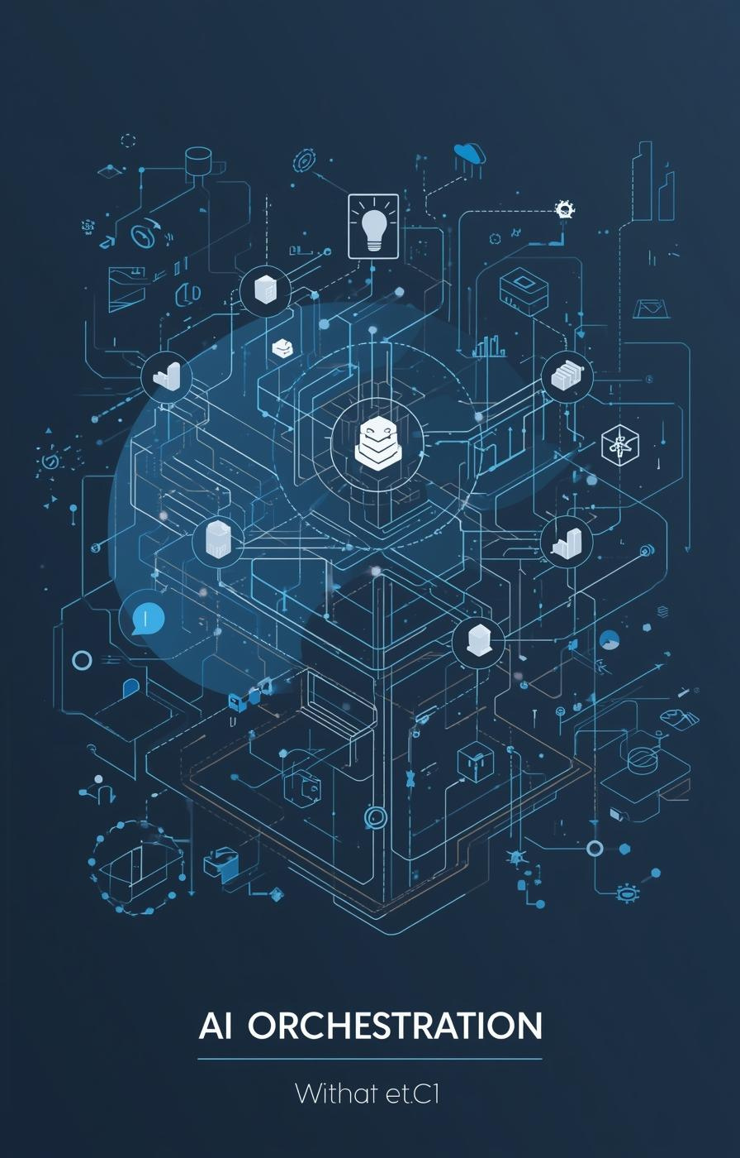

Production RAG Overview
Presented by [Your Name]

Slide 2
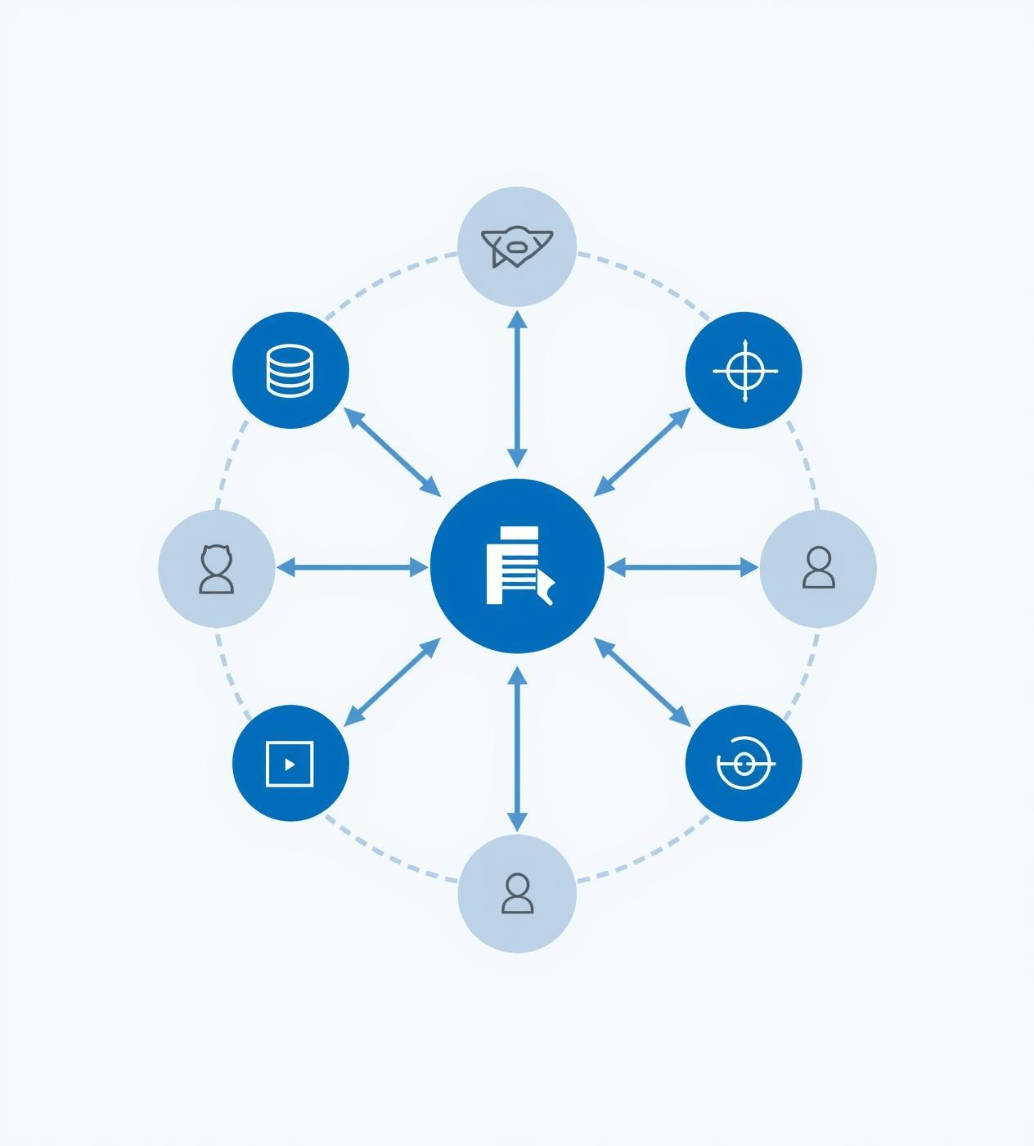
Importance of RAG in Production
RAG enhances AI reliability by addressing hallucination risks, ensuring private data control, and providing traceability, which are vital for maintaining trust and accountability in production environments.

Slide 3
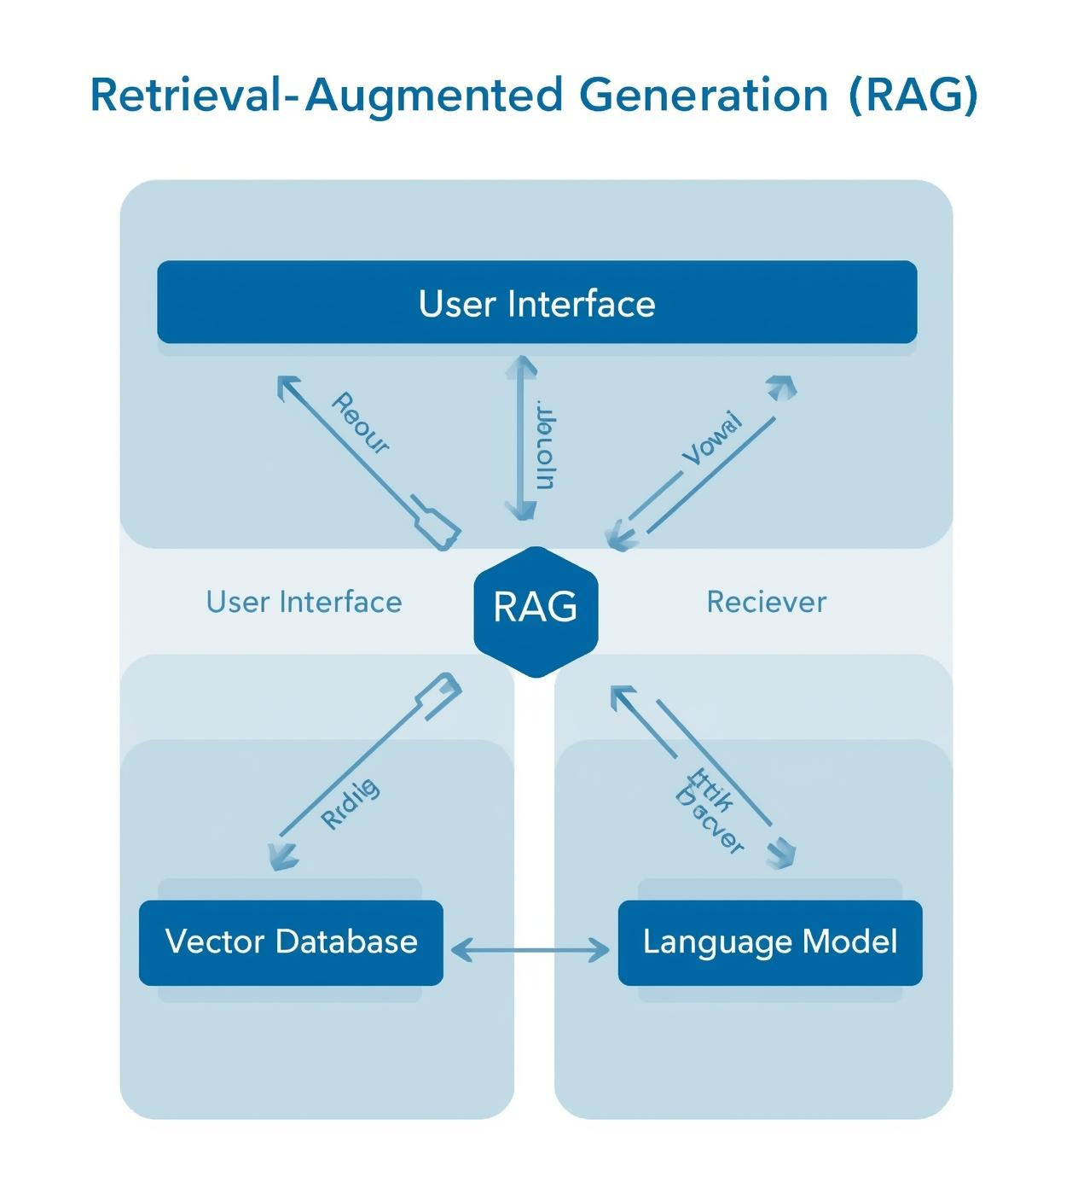
High-Level RAG System Architecture
The RAG architecture integrates user inputs with sophisticated retrieval mechanisms, including vector databases and language models, ensuring efficient data flow and response accuracy in production environments.

Slide 4
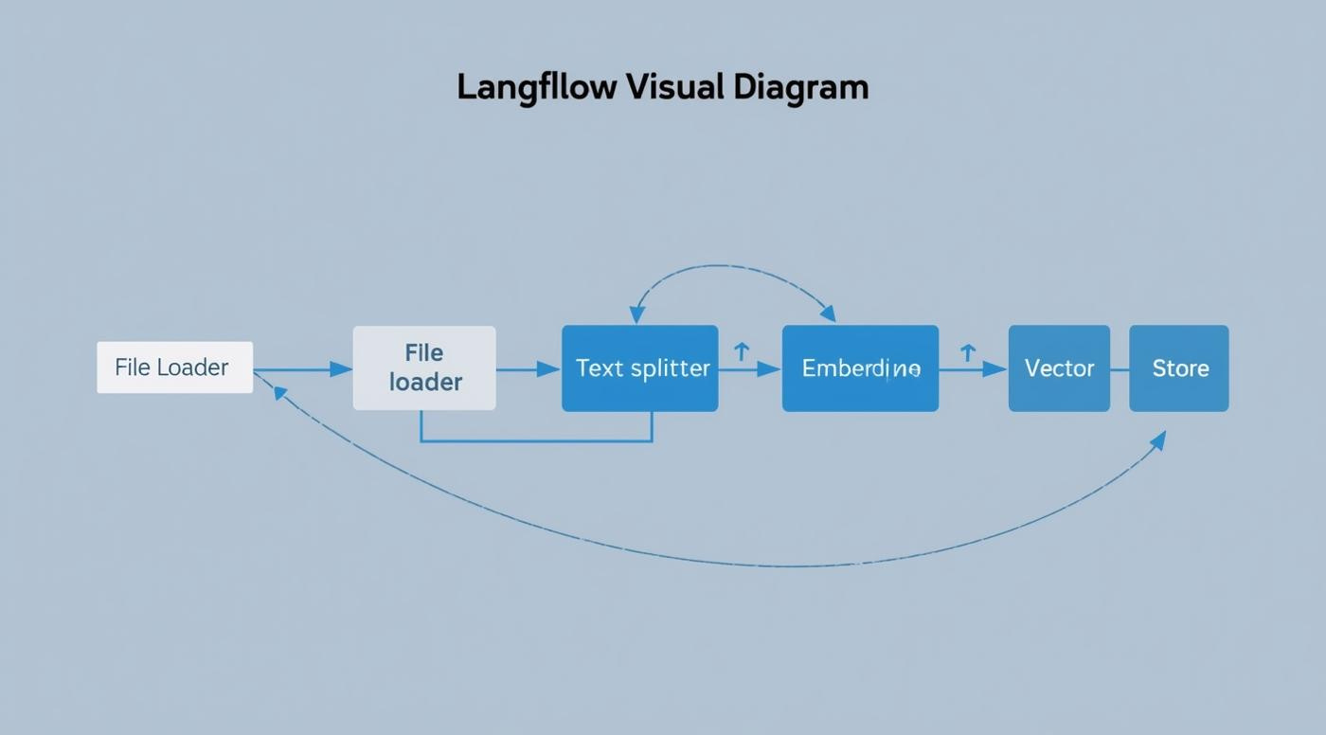
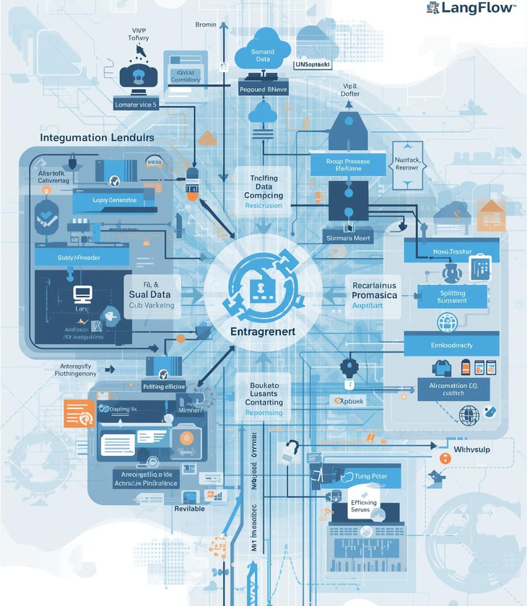
LangFlow Node Diagram

Slide 5
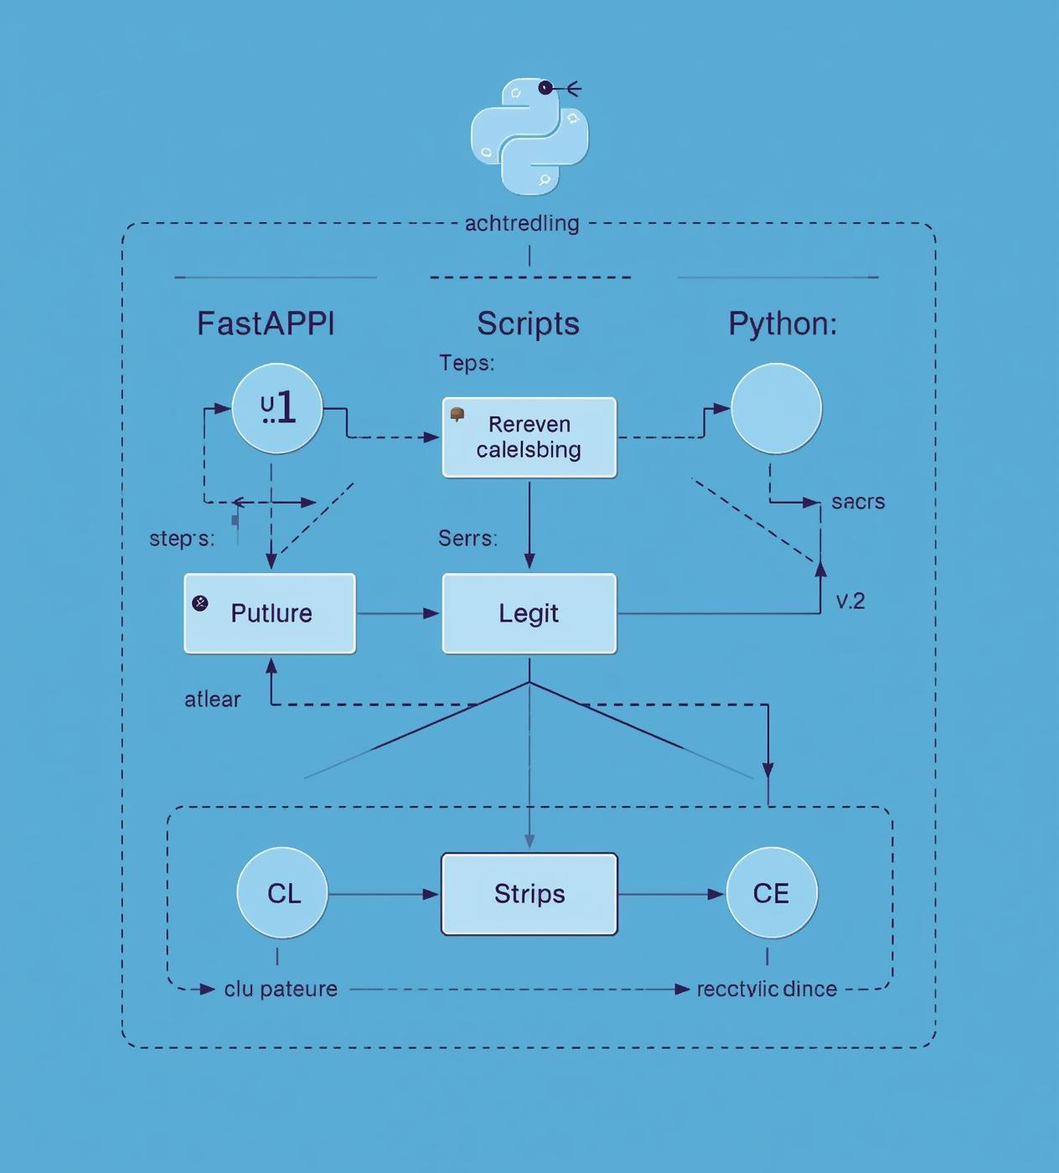
Python Backend Architecture
The Python backend integrates FastAPI for efficient API management, supporting embedding calls and retrieval logic, ensuring seamless interaction with the RAG system while maintaining high performance and responsiveness in production.

Slide 6
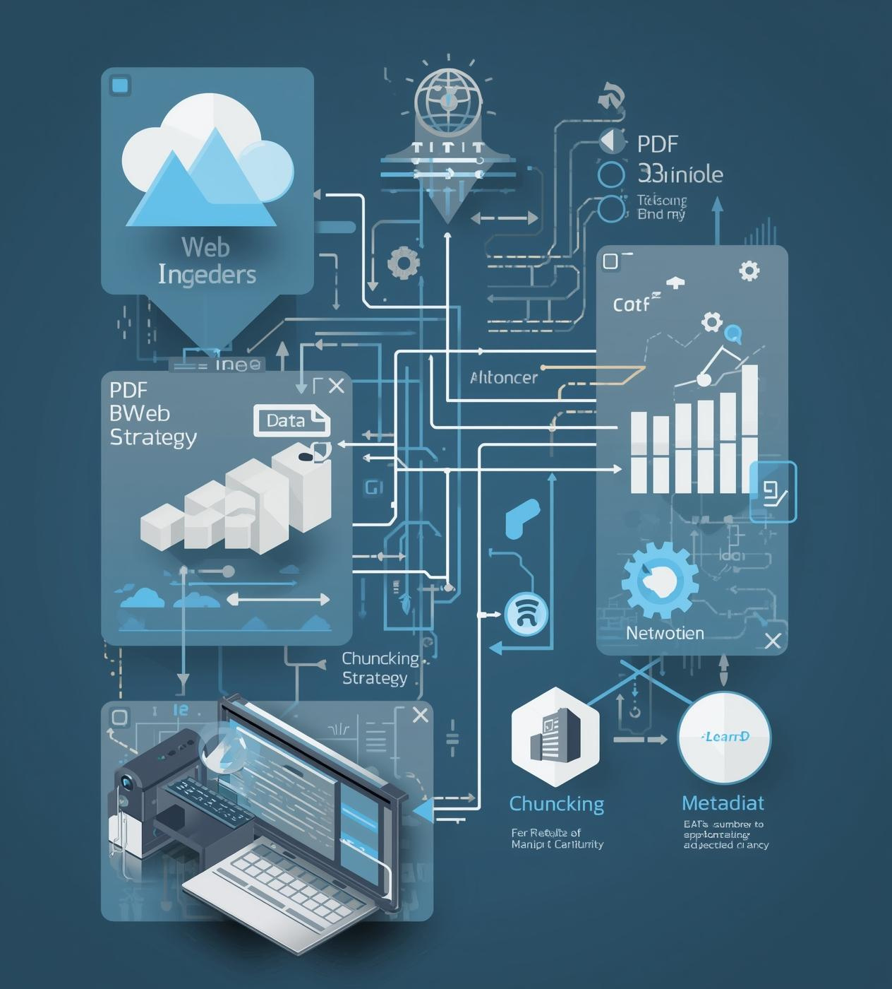
Data Preparation and Chunking
Effective data ingestion is crucial for maintaining quality. This includes using PDF and web loaders, implementing a strategic chunking method, and ensuring proper metadata integration for optimal processing.

Slide 7
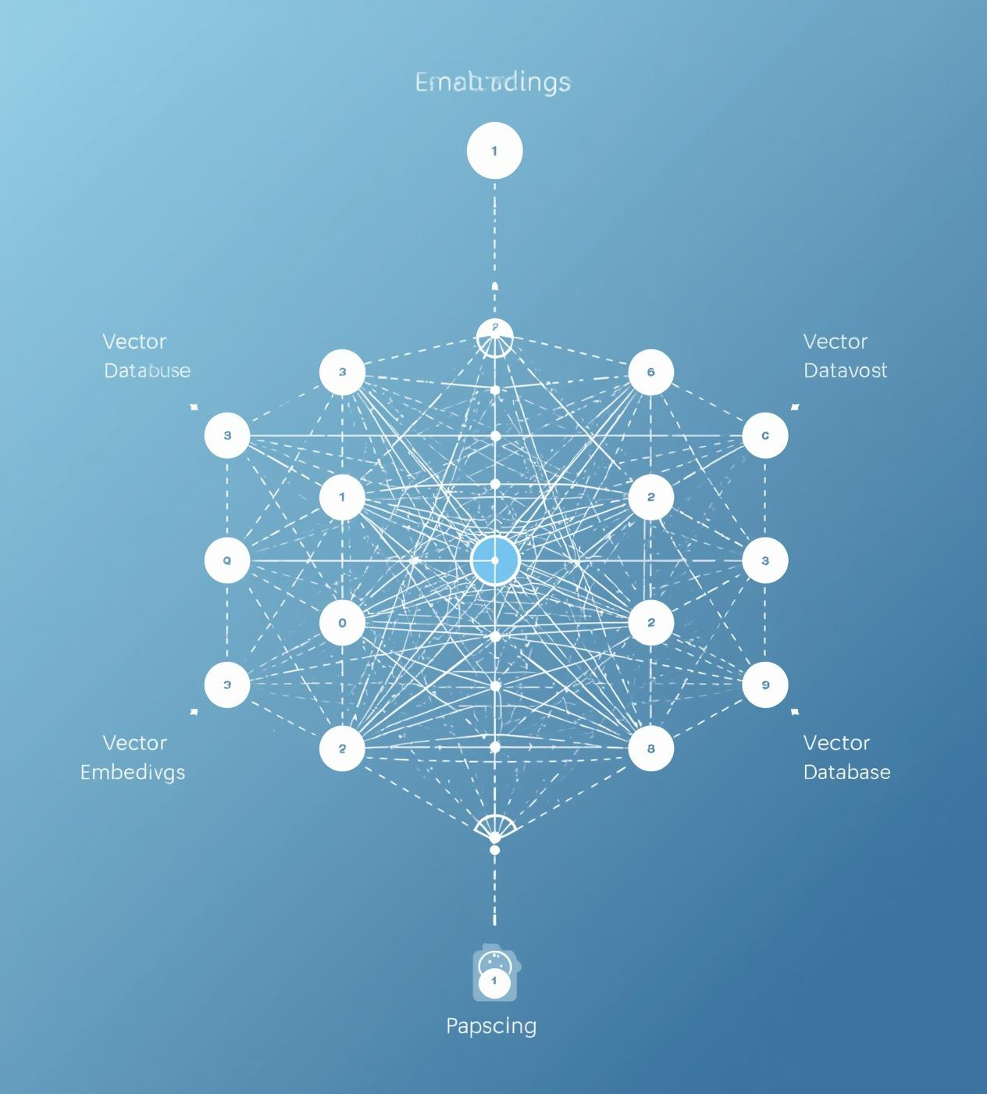
Embedding and Vector Database
Effective semantic search relies on high-quality embeddings and a well-structured vector database, ensuring efficient data retrieval while maintaining accuracy and relevance in responses generated by AI models.

Slide 8
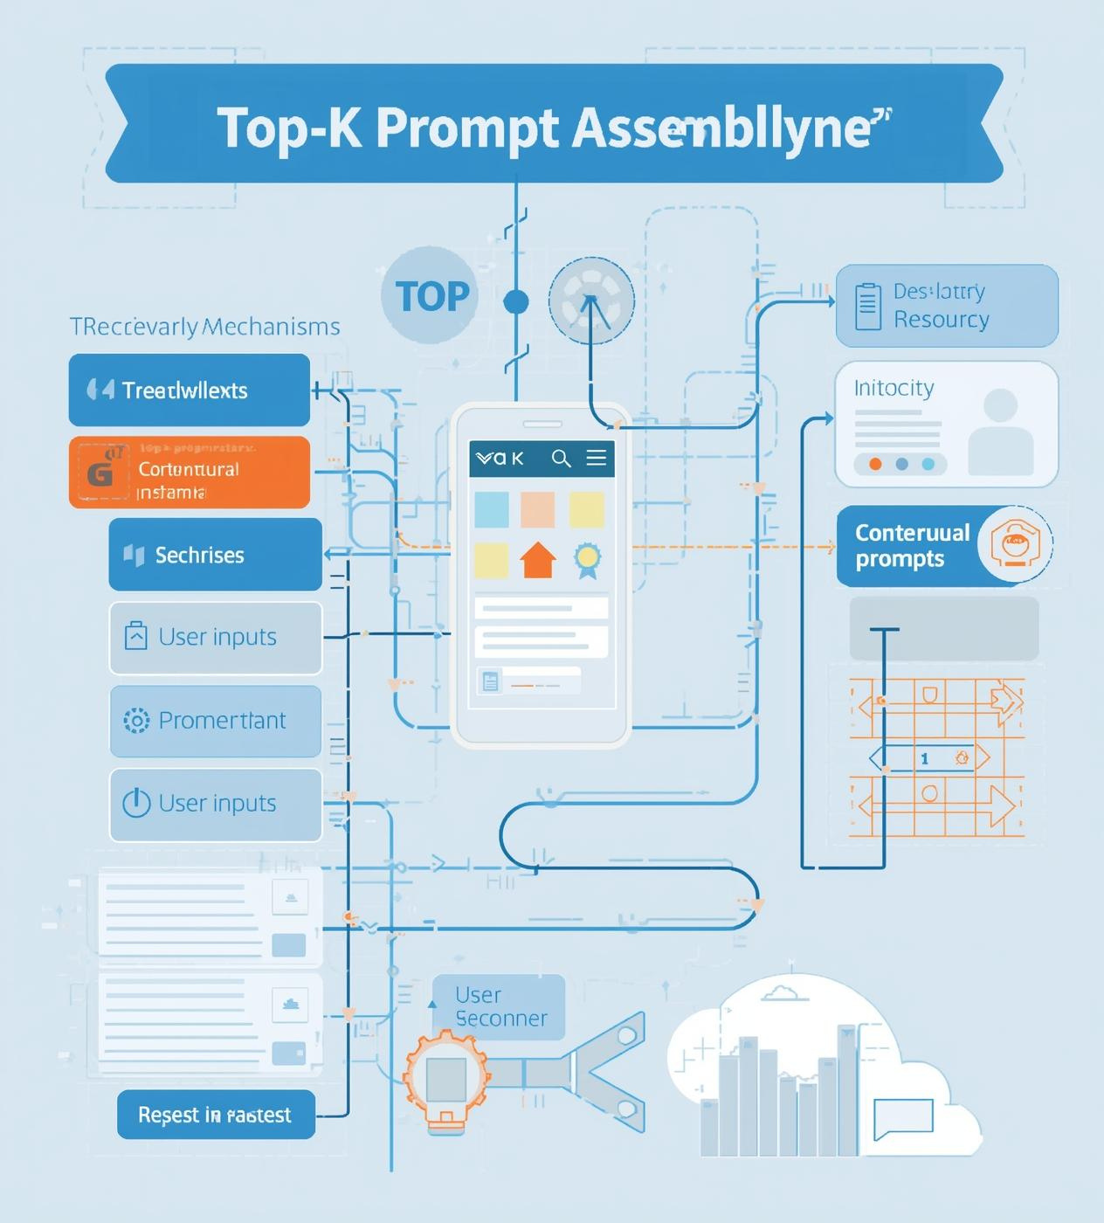
Context Building in RAG
Effective context building is crucial for retrieving relevant information. The process involves top-K retrieval and prompt assembly, ensuring that generated outputs align closely with user queries and expectations.

Slide 9
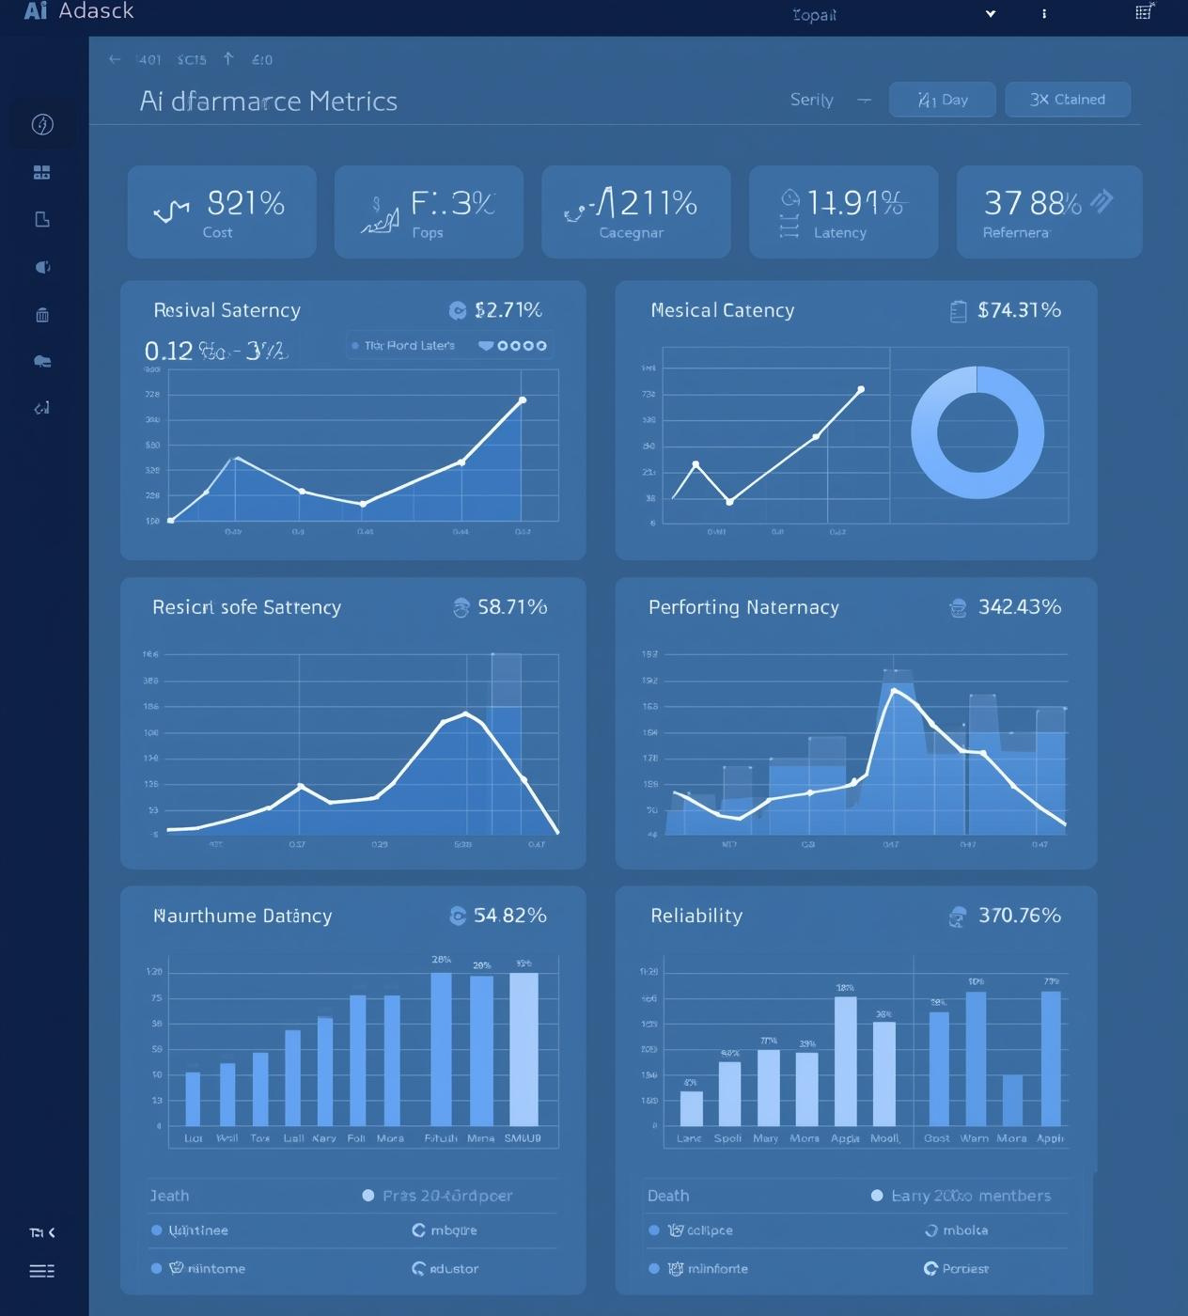
Production Checks and Metrics
Evaluating AI outputs is crucial for ensuring answer reliability. Monitoring metrics like grounding, cost, and latency helps maintain quality, making production-ready AI systems more effective and robust.

Slide 10
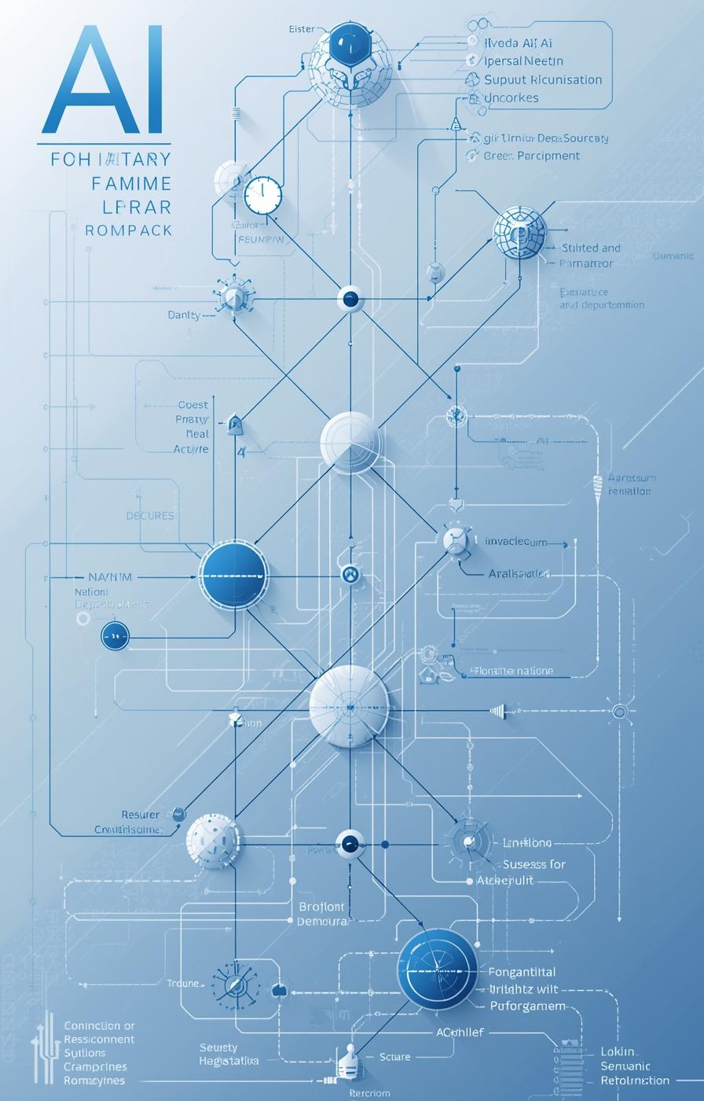
Next Steps
Scaling and enhancing our RAG system

